Slide 1
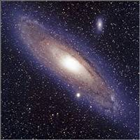
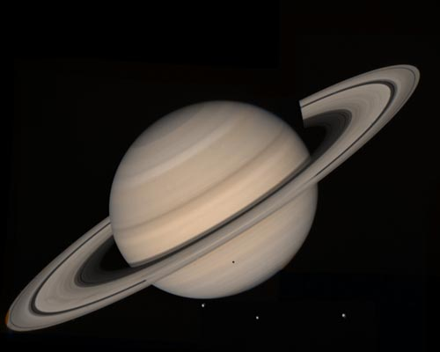
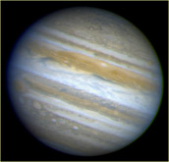
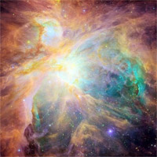
Celestial
Favorites!

Slide 2
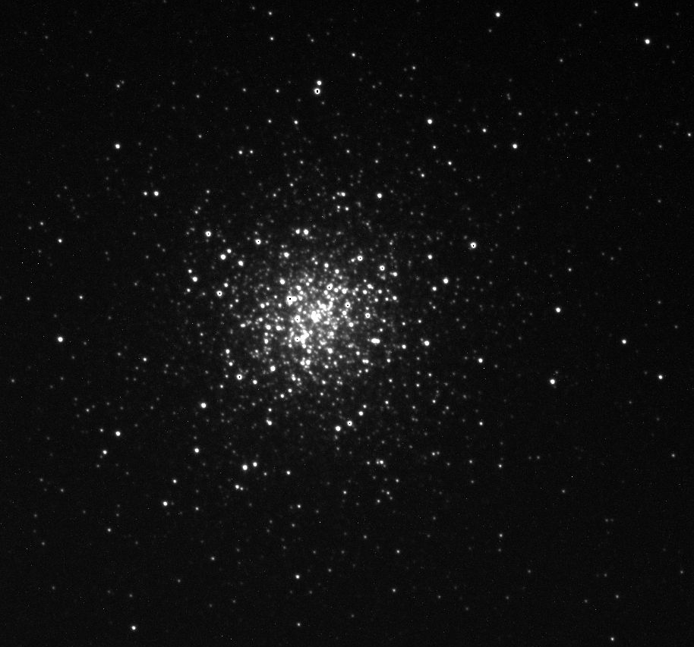
M3 Through the Telescope
M3 is 33,900 light years away from us.

Slide 3
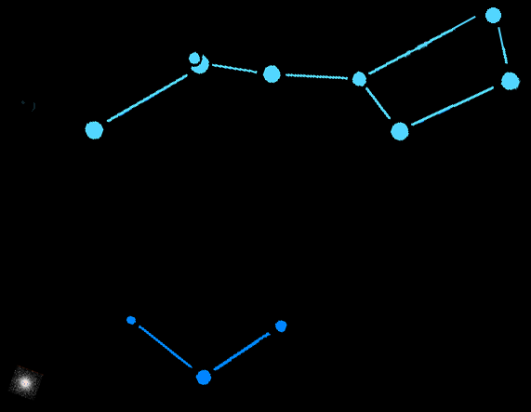
M3
M3 In the Night Sky
M3 is in the constellation of Canes Venatici (the hunting dogs).It is just below the handle of the Dig Dipper.

Slide 4
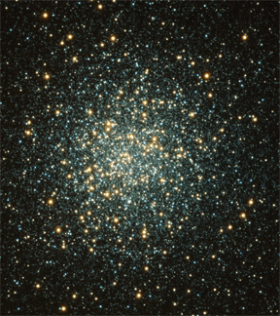
M3 is a globular cluster that is over 160 light years across and contains about 500,000 stars.

Slide 5
Detailed Image of M3
Of the 200 or so globular clusters in our Milky Way galaxy, M3 is one of the largest and brightest. It is easily visible in the Northern hemisphere with binoculars.

Slide 6
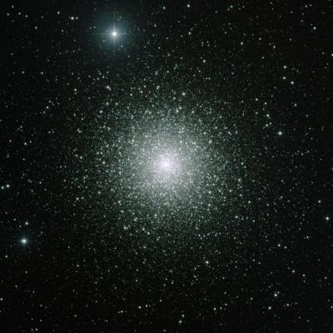
What is a Globular Cluster?
A globular cluster is a tightly packed group of about 100,000 or more stars.

Slide 7
What is a Globular Cluster?
The globular clusters of our galaxy are old! They are the same age as the galaxy itself – at least 10 billion years old.

Slide 8
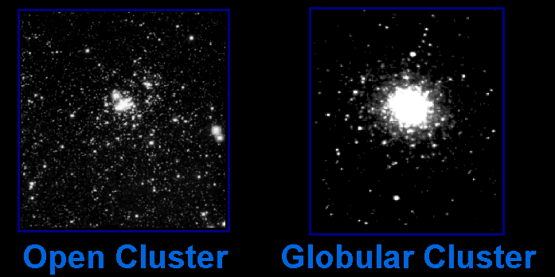
Star Clusters
There are two main types of star clusters in our galaxy …

Slide 9
Star Clusters
Star Clusters
Open clusters orbit within the disc of the galaxy. Globular clusters orbit above and below the plane of the galaxy.

Slide 10
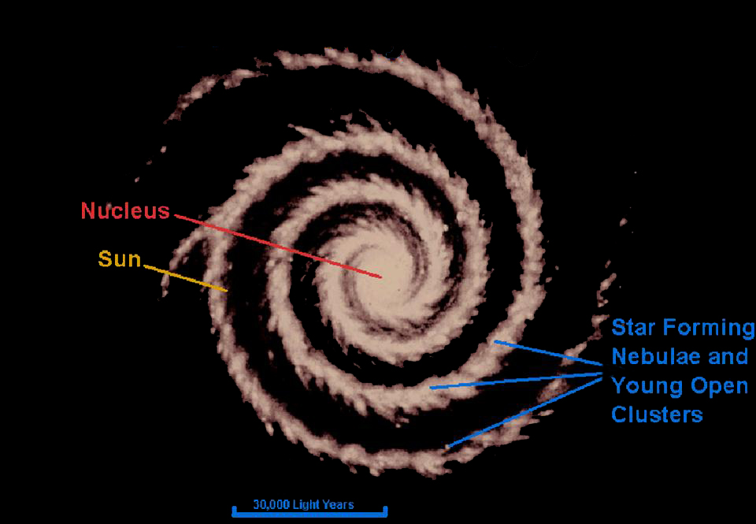
Our Milky Way Galaxy
(top view)

Slide 11
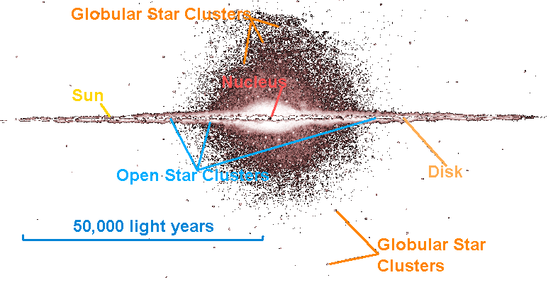
Our Milky Way Galaxy
(side view)

Slide 12
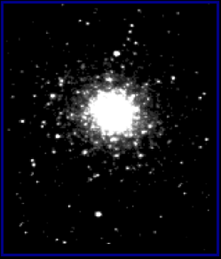

Open and Globular Star Clusters Are Different Sizes
Open Cluster
Globular Cluster
are about 30 light years across.
are about 150 light years across.
Open clusters are 5 times smaller than globular clusters. They only look the same size because they are closer.

Slide 13
Open and Globular Star Clusters Are Different Sizes
Open Cluster
Globular Cluster
have hundreds to thousands of stars.
have thousands to nearly a million stars.

Slide 14
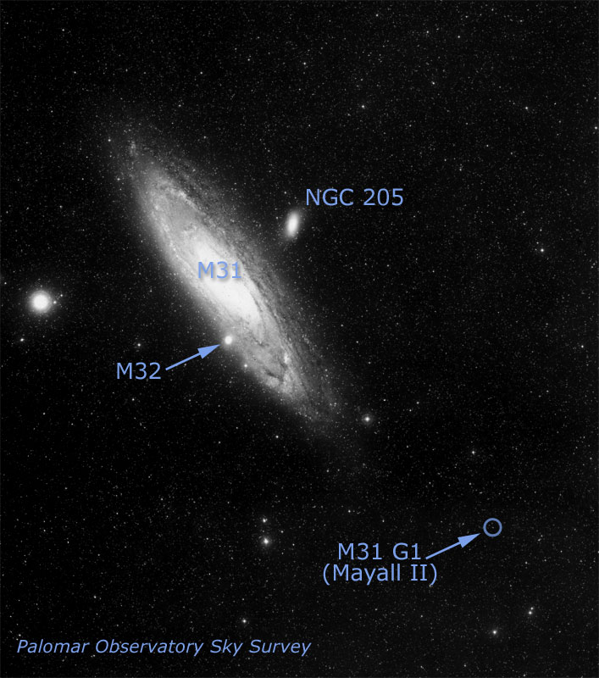
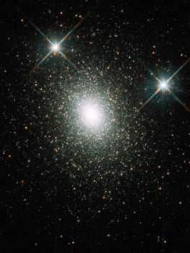
Other Galaxies Have Halos of Globular Clusters
HST image of G1
This globular cluster called G1 is in the halo of the Andromeda galaxy (M31).
This cluster has a medium-sized black hole in it!

